Slide 1
Database design and Applications Prof . Manjunath N

Slide 2
Tutorial Session : 5
RA, SQL.

Slide 3

LEARNING OUTCOME
RA

Slide 4
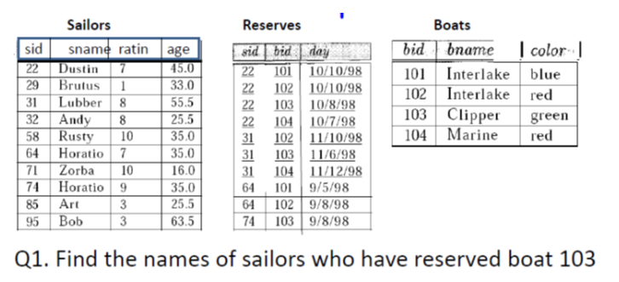
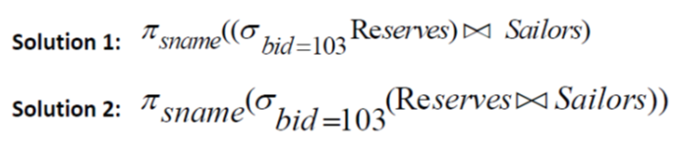
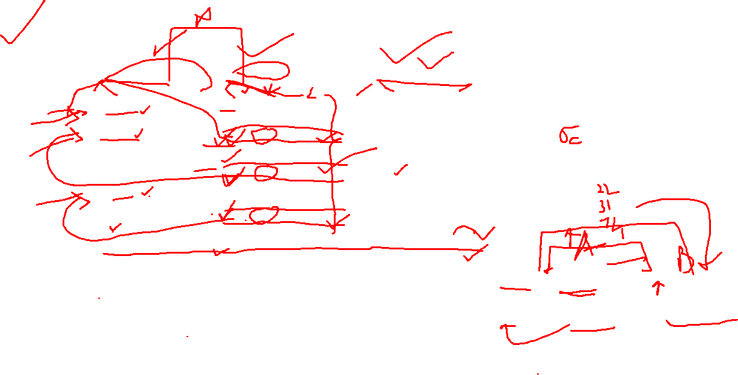
Example 1

Slide 5
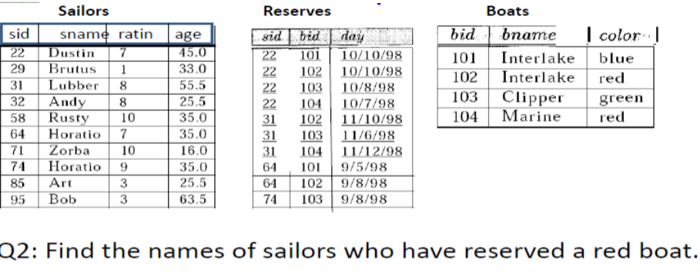
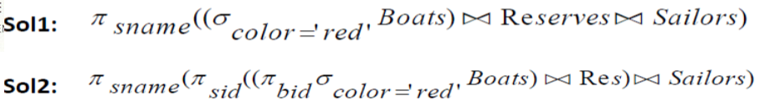
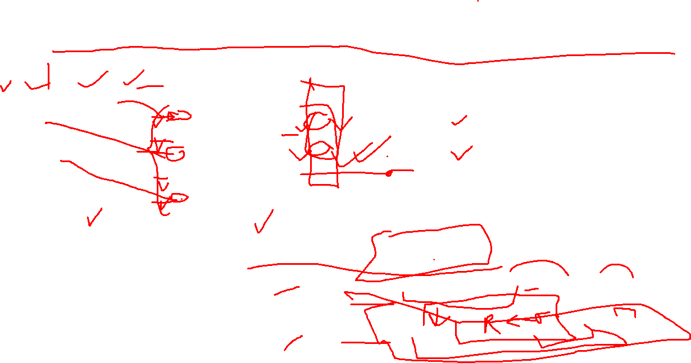
EXAMPLE

Slide 6
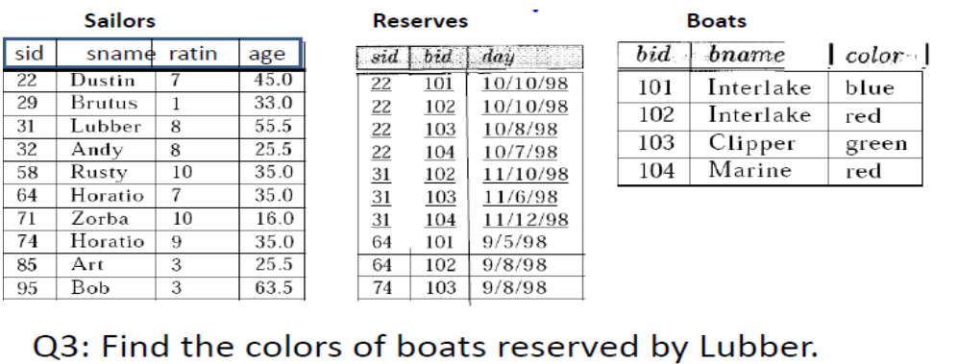
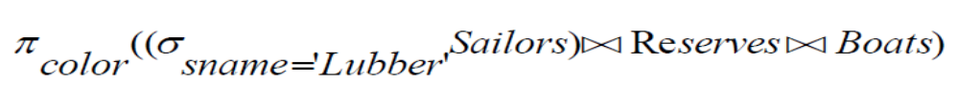
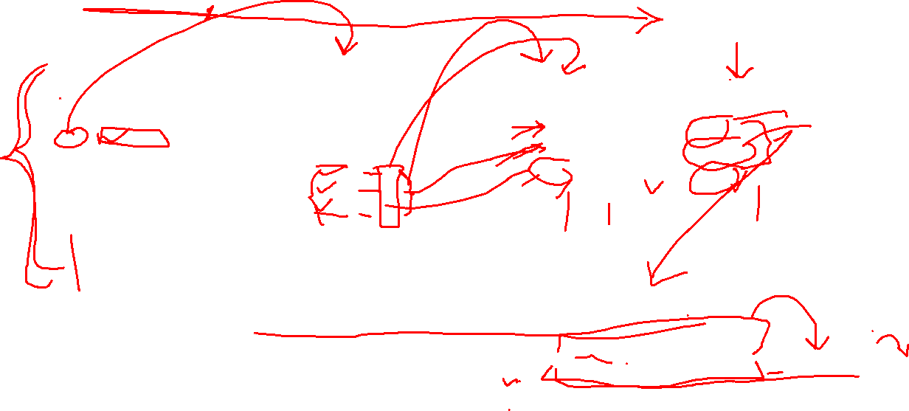
EXAMPLE

Slide 7
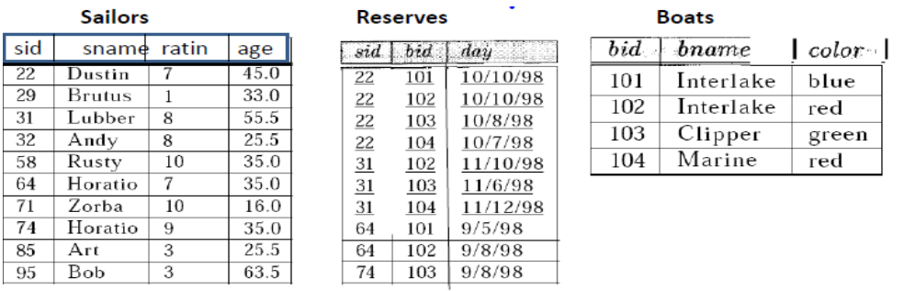
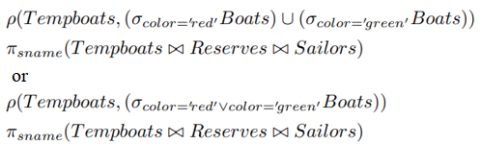
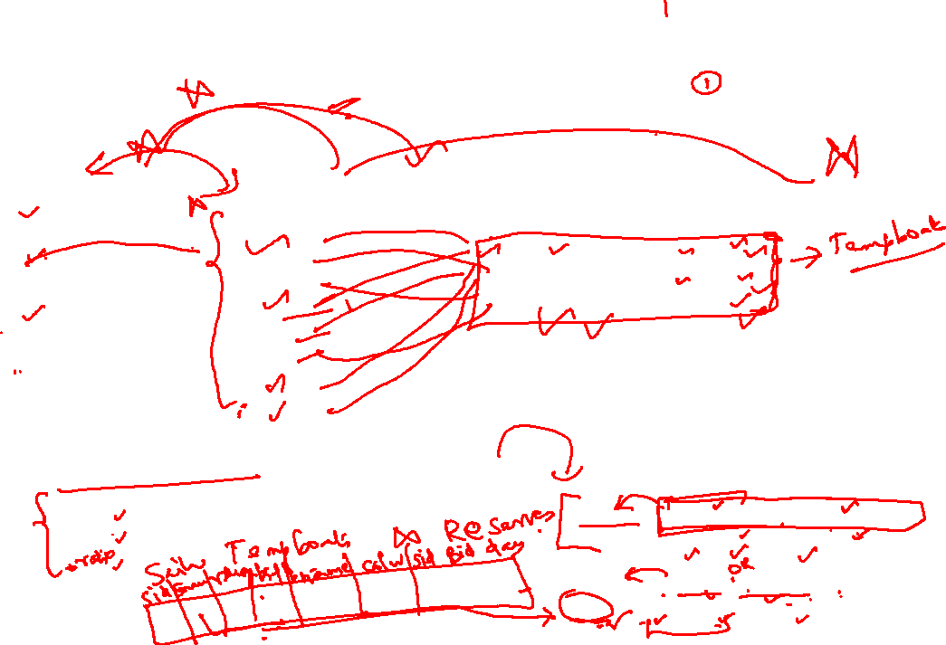
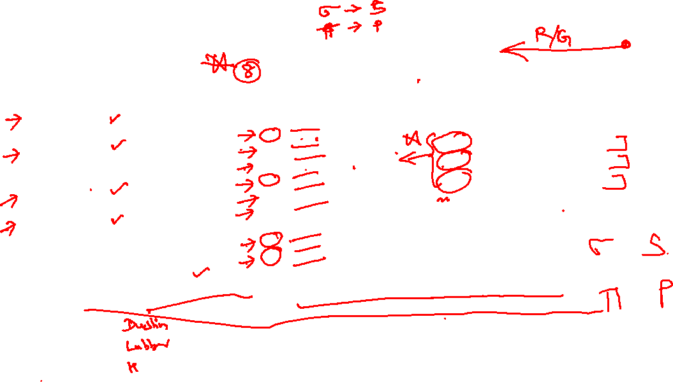
EXAMPLE

Slide 8

LEARNING OUTCOME
SQL

Slide 9
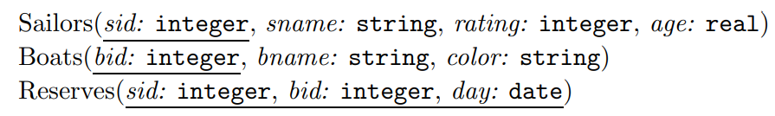
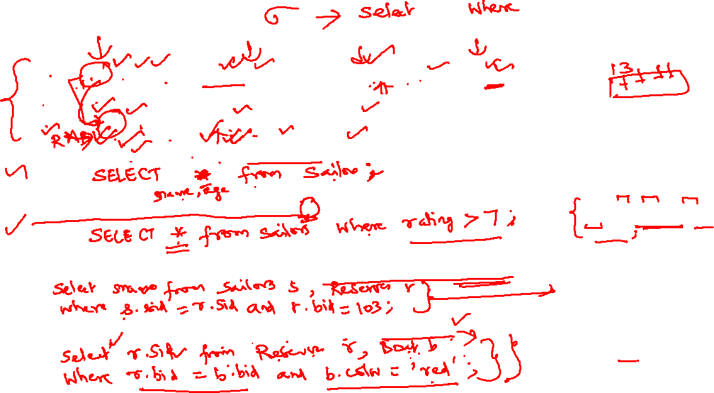
SQL tutorials
Find the names and ages of all sailors.
SELECT DISTINCT S.sname, S.age FROM Sailors S
Find all sailors with a rating above 7.
SELECT S.sid, S.sname, S.rating, S.age FROM Sailors AS S WHERE S.rating > 7
Find the names of sailors who have reserved boat number 103.
SELECT S.sname FROM Sailors S, Reserves R WHERE S.sid = R.sid AND R.bid=103
Find the sids of sailors who have reserved a red boat.
SELECT R.sid FROM Boats B, Reserves R WHERE B.bid = R.bid AND B.color = ‘red’

Slide 10
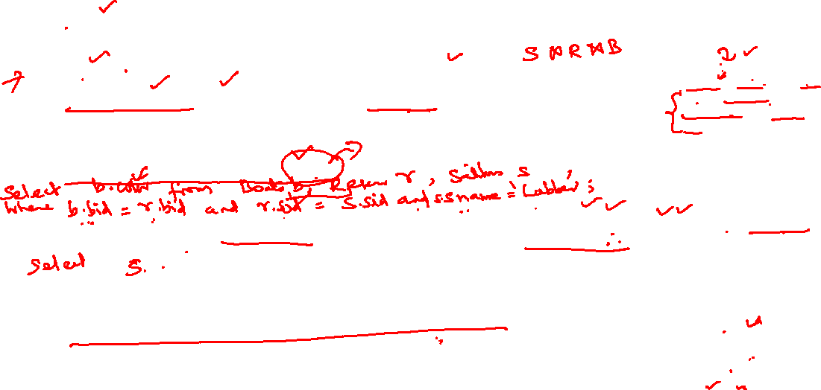
SQL tutorials
SELECT S.sname FROM Sailors S, Reserves R, Boats B WHERE S.sid = R.sid AND R.bid = B.bid AND B.color = ‘red’
Find the names of sailors who have reserved a red boat.
SELECT B.color FROM Sailors S, Reserves R, Boats B WHERE S.sid = R.sid AND R.bid = B.bid AND S.sname = ‘Lubber’
Find the colors of boats reserved by Lubber.
SELECT S.sid, S.sname, S.rating, S.age FROM Sailors AS S WHERE S.rating <20
Find all sailors with a rating less than 20.
Find the names of sailors who have reserved at least one boat.
SELECT S.sname FROM Sailors S, Reserves R WHERE S.sid = R.sid

Slide 11
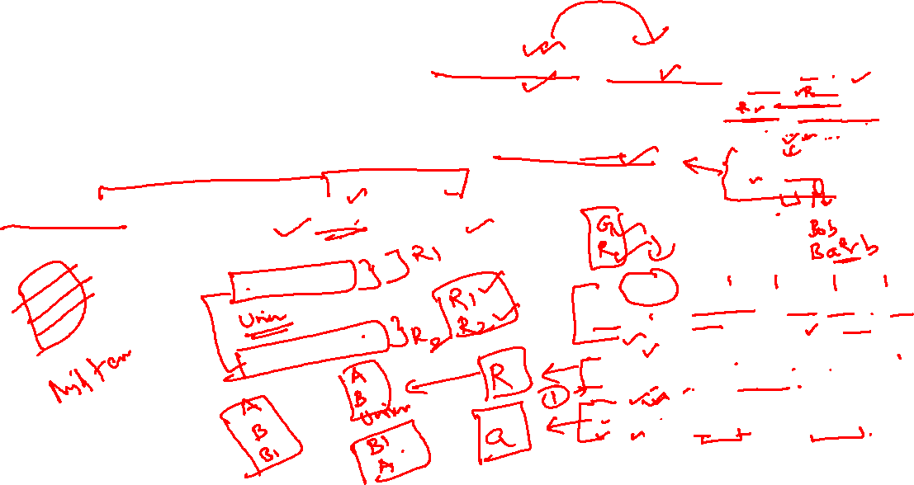
SQL tutorials
Compute increments for the ratings of persons who have sailed two different boats on the same day.
SELECT S.sname, S.rating+1 AS rating FROM Sailors S, Reserves R1, Reserves R2 WHERE S.sid = R1.sid AND S.sid = R2.sid AND R1.day = R2.day AND R1.bid <> R2.bid
Find the ages of sailors whose name begins and ends with B and has at least three characters.
SELECT S.age FROM Sailors S WHERE S.sname LIKE ‘B %B’
Find the names of sailors who have reserved both a red and a green boat.
SELECT S.sname FROM Sailors S, Reserves R1, Boats B1, Reserves R2, Boats B2 WHERE S.sid = R1.sid AND R1.bid = B1.bid AND S.sid = R2.sid AND R2.bid = B2.bid AND B1.color=‘red’ AND B2.color = ‘green’
Or
SELECT S.sname FROM Sailors S, Reserves R, Boats B WHERE S.sid = R.sid AND R.bid = B.bid AND B.color = ‘red’
UNION
SELECT S2.sname FROM Sailors S2, Boats B2, Reserves R2 WHERE S2.sid = R2.sid AND R2.bid = B2.bid AND B2.color = ‘green’

Slide 12
THANK YOU

